Slide 1
Communicating Internal Health Symptoms
Steven Emerson, LCSW & James Horan, BCBA

Slide 2
What is interoception?
What is interoception?
Interoception is colloquially known as the eighth sense (Mahler, 2017), and is a lesser-known yet crucial sense that helps individuals perceive and interpret signals originating from within their own bodies – signals such as hunger pains, thirst, fatigue, nausea, tummy flutters, a racing heart, goosebumps, sexual arousal, muscle tension, toileting urges, and even pain.
Our interoceptive awareness is mediated by a network of sensory receptors located in various organs, including the heart, lungs, stomach, bladder, eyes and skin. These receptors send signals to the insula in our brain about the state of our body’s internal environment. Our brain then uses the information about how our body feels as clues to our emotional state. Are we anxious, sick, tired or excited?

Slide 3
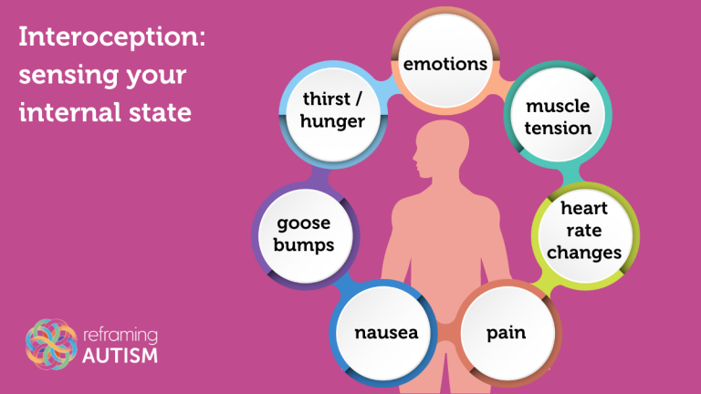

Slide 4
Interoception and Autism
Challenges in Identifying Basic Needs
Emotional Regulation Difficulties
Many Autistic individuals are also alexithymic. alexithymia is a condition in which a person has difficulty identifying and describing their emotions and is closely associated with interoception differences
Heightened or Diminished Experiences of Pain

Slide 5
Strategies for Support
Engaging in Interoceptive Awareness Training
Involving Visual Supports and Communication Tools
Providing Consistent Routines
Modifying our Environment
Making Space for Stimming
Offering Understanding and Validation
Using the Correct Language for the Body
Recognition Vs. Communication

Slide 6
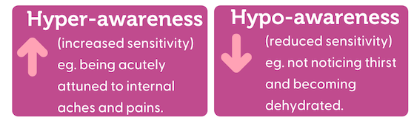
Hyper-Awareness Vs. Hypo-Awareness

Slide 7
Understanding Medication and Diet Restrictions
Side Effects
Staying connected with child’s doctor
Journal/log patterns and changes at home/school
Include bathroom usage, appetite, sleep, and other important daily functions.
Consider discussing supplements with doctor when diet restrictions are a concern.

Slide 8
Tools for Communicating
Augmentative and Alternative Communication (AAC)
Visual Aide
  Pain Charts
  Body Chart w/ labels
  Physical/Printed Picture Exchanges
  Sign Language

Slide 9
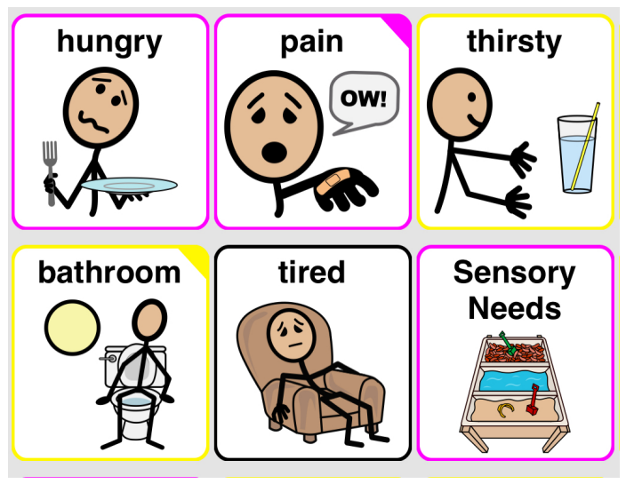
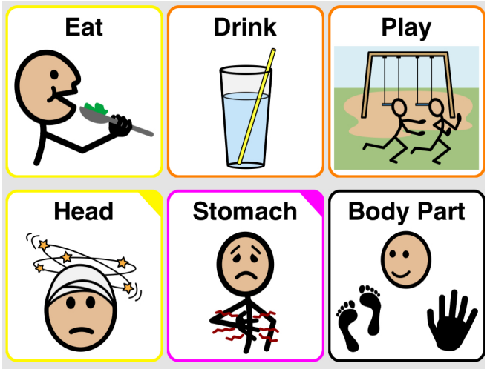
Examples:

Slide 10
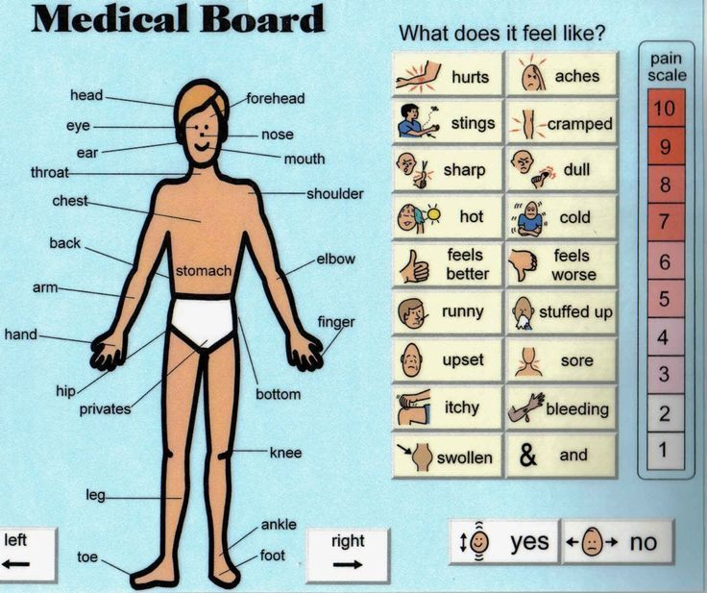

Slide 11
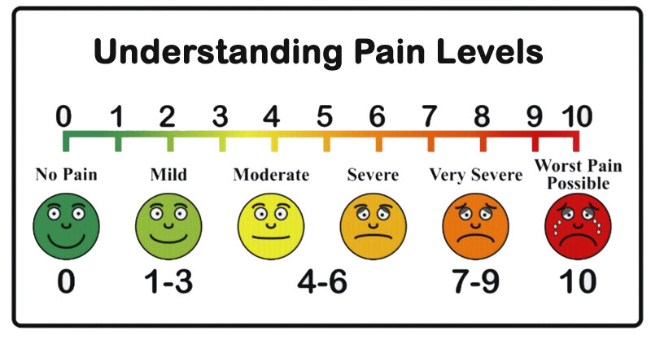

Slide 12
References
https://reframingautism.org.au/interoception-knowing-yourself-inside-and-out/

Slide 13
Contact
James Horan, BCBA/LBA
Senior Teacher
jhoran@hawthornecountryday.org
(914) 592-8526, ext 2021
Steven Emerson, LCSW
Counselor
semerson@hawthornecountryday.org
(914) 592-8526, ext 2036

