Slide 1
Please turn off camera and change name if you do not want it recorded

Slide 2
Sibling Engagement
for Children with ASD

Slide 3
Why Sibling Engagement Matters
Emotional and social support: Siblings can model patience, empathy, and positive behaviors, reinforcing skills learned in therapy www.magnetaba.com.
Family cohesion: Involving siblings in autism therapy (e.g., ABA) normalizes the process, builds understanding, and strengthens family bonds www.magnetaba.com.
Skill generalization: Shared activities like cooperative play, mealtime routines, or joint projects help siblings practice turn-taking, communication, and problem-solving www.magnetaba.com.
Reduced stigma and increased empathy: Education about autism helps siblings understand behaviors, reducing frustration and fostering compassion www.magnetaba.com.

Slide 4
How to Engage Siblings Effectively
Provide education and resources – Offer age-appropriate materials
Encourage participation in therapy – Include siblings in ABA sessions, goal-setting, and family activities to reinforce skills and build teamwork.
Foster inclusive play and routines – Use structured play and shared routines to practice social skills and reduce conflict

Slide 5
How to Engage Siblings Effectively (continued)
Support mental health – Access sibling support groups (e.g., Sibshops) to address feelings of isolation, role stress, or depression Association
Promote role clarity – For adolescents, especially sisters caring for brothers, clarify boundaries and responsibilities to prevent role conflict pmc.ncbi.nlm.nih.gov.

Slide 6
Benefits of Engagement for the Family
For siblings: Improved self-esteem, reduced stress, and stronger relationships with their autistic sibling Association for Science in Autism Treatment.
For the autistic child: More consistent modeling of positive behaviors, better generalization of skills, and a supportive family environment.
For the family: Enhanced communication, cooperation, and emotional resilience.

Slide 7
Applied Behavior Analysis (ABA) and Social Skills
Positive Reinforcement: Reward appropriate social behaviors to encourage repetition.
Modeling and Role-Playing: Practice social scenarios in a controlled environment.
Individualized Strategies: Tailor interventions to your child's specific needs and progress.

Slide 8
Applied Behavior Analysis (ABA) and Social Skills
Social Stories: Use narratives to explain social situations and expected behaviors.
Visual Supports: Implement visual cues to guide social interactions.
Group Sessions: Participate in group therapies that focus on practicing social skills in a safe setting.

Slide 9
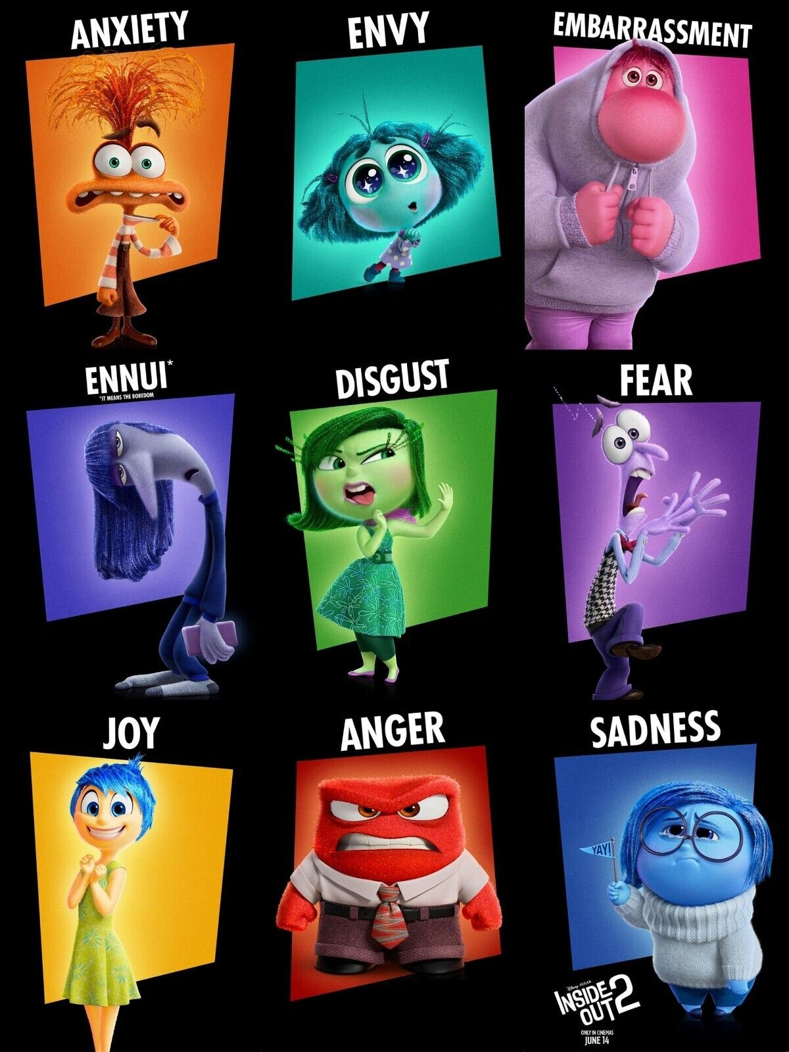
Teach feelings in a relatable way
Emotional Awareness
  Identifying feelings
Emotional Communication
  “I feel”, “I need”, “I want”
Empathy
  Recognizing feelings in others
Emotional Control / Coping Skills
  ex: Deep breathing, finding a creative outlet, physical activity

Slide 10
Stages of Play and Where to Begin
Unoccupied play: Child appears uninterested in engaged in activities, but this stage builds the foundation for the next five stages of play. May seem scattered in movements or wandering without functions. This allows for children to manipulate materials, explore, and learn self-control in their environment.
Solitary play: This is where the child engages in appropriate play with a toy but does not engage with peers. Solitary play could look like a child rolling a car or building by themselves. By playing alone the child is preparing to play with others. The child is practicing new cognitive and motor skills, as well as exploring with toys freely.
Onlooker play: The child is watching other peers engaging in play behavior but does not join. It has been found that the basis is learning is through observation. This is a chance for children to observe the rules of play, different ways to play, building relationships, and using materials in other ways. They could watch a game of tag or others building a train track. Watching peers is the active part of their play in this stage.

Slide 11
Stages of Play and Where to Begin
Parallel play occurs when the child is playing close to peers, about three feet, but they are not interacting with each other. Children could be building block towers or coloring at the same table. Parallel play is thought of to be like a warm-up stage, where children are engaged in the same activities side-by-side but not yet engaging in social exchanges.
Associative play means the child is changing and developing. Two or more peers are acknowledging each other and engaged in the same play activity. They might be practicing the skills they have observed in earlier stages, like the onlooker and parallel play. Children start to become more interested in others while playing versus being more interested in the activity.
Cooperative play is based on the cooperation between peers. In this stage, each child has a specific role and should follow explicit or implied guidelines. However, cooperation is a challenging skill for young children which leads to conflict. Taking turns and sharing could be some reasons why conflict occurs, but this is completely normal. It is important to provide support for children during these times of conflict so stay close. Parents, teachers, and service providers can teach problem solving skills and healthy emotions and how to express them.

Slide 12

Questions
&
Comments

Slide 13
Thank you!
Steven Emerson, LCSW
School Counselor
Semerson@Hawthornecountryday.org
James Horan, BCBA/LBA
Senior Teacher
Hawthorne Country Day School
jhoran@hawthornecountryday.org

